Slide 2
Administrative Details
Attendees are in listen only mode.
Questions? Please use the Gotowebinar questions feature in the upper right and we will do our best to respond.
For panelist questions after the webinar:
Ron Berg- RonBerg@iiaba.net
Matt Davis- Matthew_Davis@swissre.com
Jim Keidel- jkeidel@kwcllp.com
Richard Lund- Richard_Lund@swissre.com
No CE or loss control credit for listening to today’s discussion.
The slides and audio will be available on E&O Happens soon.

Slide 3
Our Panelists:
Ron Berg- Ron worked with MetLife Auto & Home for almost 20 years, advising on future technology strategies and advocating for effective agent workflows. He has also long been involved with insurance industry workgroups and associations such as ACT, AUGIE, the ID Federation, the Insurance Digital Revolution, the Real Time/Download Campaign, and numerous other user group conferences. Ron has a wide technology background in computer operations, programming, technical support management, and project management.
Matt Davis- Matthew is a Vice President and Claims Manager at Swiss Re Corporate Solutions in Overland Park, Kansas, with 26 years of experience working in and for the insurance industry. He joined Swiss Re in 2004, where he has focused his attention on professional liability claims involving both insurance agents and lawyers throughout the United States and Canada.
Jim Keidel, Esq.- Jim spent his entire legal career handling E&O claims and lawsuits and state regulatory matters involving insurance agents and brokers. He regularly writes articles, presents seminars and webinars, conducts agency audits, and counsels insurance agencies and brokerages regarding E&O loss control prevention. During the past thirty years, Jim has handled, managed and supervised over 6,000 E&O claims, lawsuits and regulatory matters involving insurance agents and brokers across the country.

Slide 4
Ron Berg, Executive Director Agents Council for Technology

Slide 5
ACT – What & How
Big “I” Program bringing IA stakeholders together since 1999 – FREE for IAs
Advancing effective:
Technology workflows, business processes
Our Goal: Consensus on best workflows, advocacy using Work Groups
Strategic Future Issues, Changing Nature of Risk
Customer Experience, Security Issues
Disaster Planning, Small Commercial Real Time Rating

Slide 6
The CX Journey
Customer Expectations are CHANGING
Forces at Work:
New Behaviors
New Technologies
Competitive Pressure
New Buying Journey

Slide 7
Mobile First
First; MOBILE
85% of insurance shopping now starts on mobile *
66% depart if not optimized *
Google now ranks “mobile-usability” higher
92% of smartphone time is spent with apps.
* Source: comScore 2018 Online Insurance Shopping Report

Slide 8
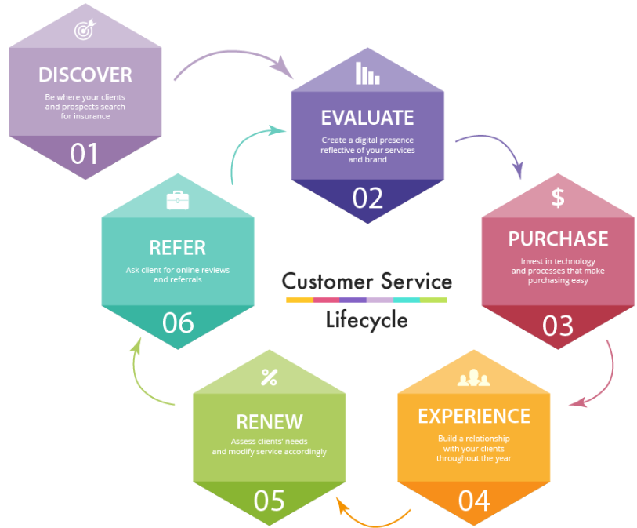
The CX Lifecycle
Six phases, critical touchpoints
Six phases,
Critical ‘Touchpoints’

Slide 9
The CX Planning website
New: Free interactive online CX planning tool
https://www.independentagent.com/ACTCX

Slide 10
The Customer Experience Work Group
Coming next:
Adding Agency CX assessment/project planning
https://www.independentagent.com/ACTCX

Slide 11
ACT
Other resources:
Agency Social Media Policy
‘Agency Website Privacy Notice’ template
Note: requites Big ‘I’ Id/password to access

Slide 12
Texting
Are you texting? Most are!
You need to cover your E&O
ACT/IIABA ‘Agency–Customer Text Messaging Agreement’ template
* Requires Big ‘I’ ID & password to access/download
Addressed:
Agencies need Opt-in/Out,
Text msg subjects allowed (TCPA regulation)
Integration – agency management systems

Slide 13
Matt Davis, Claims Manager, Vice President Swiss Re Corporate Solutions

Slide 14
“My website? It’s just an ad…”
Why getting social media right matters…
What’s your standard of Care: ‘Order taker’ or ‘Duty to Advise’?
A ‘special relationship’ creates a ‘Duty to advise’
The agent agrees to advise the customer;
The agent accepts additional compensation for advice;
A (long-term) course of dealing of reliance on the agent’s advice;
The agent holds himself out as an expert and the customer relies on that representation;
The customer specifically requests advice; and
The agent makes representations about the coverage upon which the customer relies.
Even in ‘Duty to advise’ states you’re helping the plaintiff’s case

Slide 15
“An Unwinnable Position”
Florida hurricane claim
The customer was a medical vocational school with multiple campuses -- a very sophisticated buyer of insurance. Its CFO had business and accounting degrees from Harvard.
Website promised that the Agency would:
Keep up with their insured’s ever growing business and business needs,
Regularly visit the business,
Make risk assessments,
Calculate the correct limits,
Help the insured come up with the correct amount of business interruption coverage.
And that, as a result, the business would be “fully insured”

Slide 16
An “Unwinnable Position”
“I had the pleasure of sitting through several hours of deposition questioning dealing with this one advertisement. Needless to say, our client was put in the unwinnable position of trying to disagree with their own website and promotional materials. They had to agree with what was on that pamphlet which defeated one of our best defenses.
The outcome of that situation was that we probably ended up paying several hundred thousand dollars more in part because of their website/advertisement.”

Slide 17
‘An “expert” in the field’
Dental Office Package Policy
The insured placed a Dental Office Package Policy.
The customer had a computer crash with loss of data that incurred when an IT contractor was working on the system.
The customer also suffered loss of income and extra expenses.

Slide 18
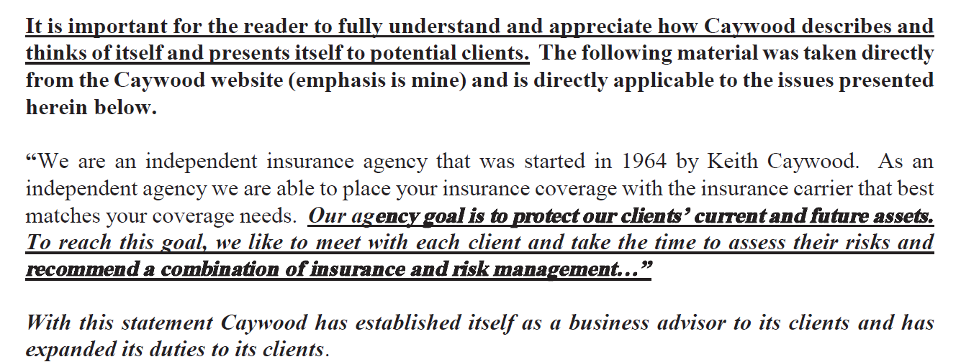
‘An “expert” in the field’
In a ‘Forensic Legal Audit’ delivered pre-suit, plaintiff quotes the agency’s website:

Slide 19
‘An “expert” in the field’
The discussion continues:

Slide 20
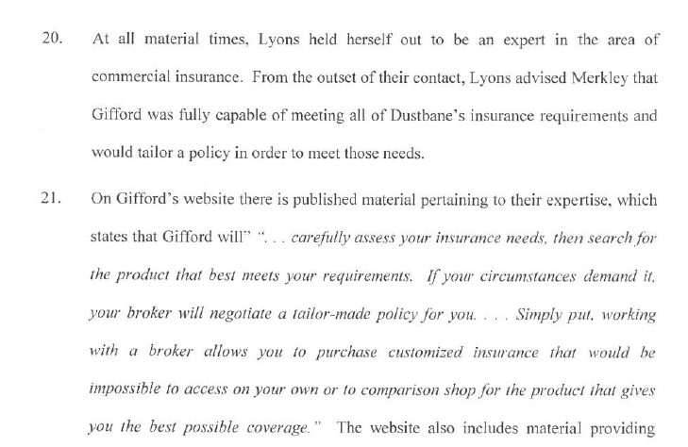
“A tailor-made policy for you…”

Slide 21
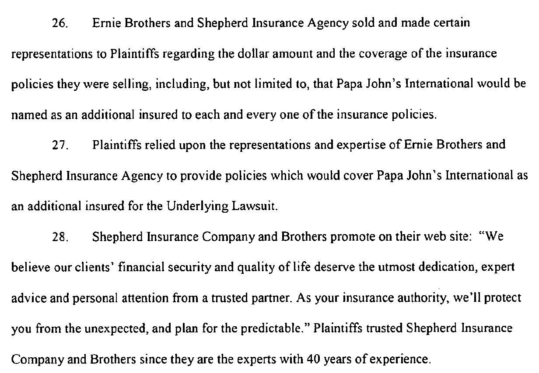
“…expert advice…from a trusted partner”

Slide 22
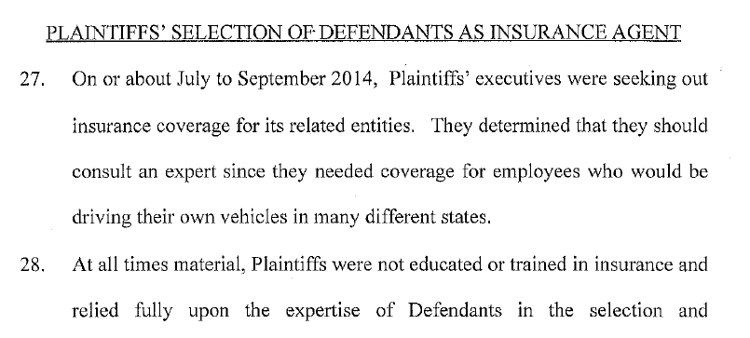
“…the best insurance coverage possible.”

Slide 23
“…the best insurance coverage possible.”

Slide 24
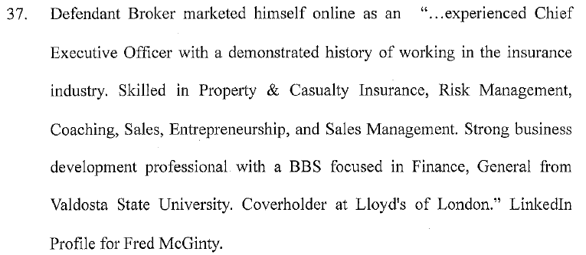
“…the best insurance coverage possible.”

Slide 25
Swiss Re Corporate Solutions Claims Digital Marketing Dangers

Slide 26
I’ll text you...
A policy was issued with wind and hail coverage for a coastal agency’s customer that covered its 2016 Hurricane Matthew loss. Thereafter, and unbeknownst* to the agency, the carrier issued a mid-term endorsement deleting the wind and hail coverage. The policy renewed in 2017 with the endorsement still on *the policy.
In September 2017 the agent received an inquiry from the customer regarding coverage. The agent was out of the office and the client needed a* quick response to his text, so the agent texted him back without the ability to access the agency's files. The information provided was incorrect due to* the endorsement.

Slide 27
James C. Keidel, Esq., Managing Partner at Keidel, Weldon & Cunningham

Slide 28
Using Text Messages To Communicate
Is anyone at the agency/brokerage communicating with insureds, insurers, or anyone else, by text message
If so, is there information in those text messages that may be important documentation that the agency/brokerage may need later on
Are the text messages being retained as agency documentation in the agency management system
As with any form of documentation, the agency/brokerage should have a policy in effect regarding when and how text messages are retained

Slide 29
Statements Made On Social Media May Be Used Against An Insurance Agency/Brokerage In An E&O Claim or Lawsuit
We have seen all types of information put out by insurance agencies/brokerages that attorneys have tried to use against them in E&O claims and lawsuits
In the past it has been statements made in marketing materials, brochures, advertisements, radio commercials, on-hold messages, etc.
Now, it is the information that put on the internet that can be problematic for insurance agencies/brokerages

Slide 30
Sometimes Social Media May Be Treated Too Casually And Not As Seriously As Other types Of Publications
Social media postings should be treated the same way as other communications from the agency/brokerage are treated
Remember that the information posted on social media will be out there indefinitely
The information posted by an agency/brokerage on social media may possibly be used against it

Slide 31
There Is Good News
We have not yet seen social media postings used against insurance agencies/brokerages in connection with E&O claims and lawsuits

Slide 32
But, There Is Also Some Bad News
Social media postings may be the basis for regulatory action against insurance agencies and brokerages

Slide 33
When Can A Social Media Posting Be The Basis For Regulatory Action Involving Insurance Agencies/Brokerages
This can potentially arise in connection with advertising laws and regulations
When is a social media posting considered to be an advertisement
If the posting is considered to be an advertisement then it must comply with all legal requirements for advertisements
Failure to comply with all of the legal requirements for advertising can result in a regulatory action involving the agency/brokerage

Slide 34
NY Department Of Financial Services Office Of General Counsel Opinion On Social Media Postings
The NYDFS has issued an opinion concerning social media postings by insurers or agents/brokers
The Department has stated that information posted on a LinkedIn page, or a similar site, that is intended for the promotion of insurance, by insurers or insurance agents and brokers constitutes an advertisement, announcement, or statement under the Insurance Law
As such, the information posted must comply with all legal requirements related to advertisements

Slide 35
Examples Of Situations Where Insurance Agencies/Brokerages Can Encounter Problems With Social Media Postings
Social media posting referring to a customer testimonial stating that they received a specific amount of savings by using the agency/brokerage
Misleading language contained in a social media posting
Social media content that failed to meet all of the legal requirements for advertising

Slide 36
A Question That I Received From A Producer Recently Regarding a Social Media Posting That He Had Seen
A customer posts on social media and the producer sees it (because they have friended each other). In the post the customer says that they were having a really bad day because they were just in a car accident
How should this information be treated by the producer

Slide 37
Things To Consider
Is the agency/brokerage on notice of a claim that needs to be reported
Is the agency/brokerage obligated to do something/anything in connection with the customer’s accident/claim
Is this really any different than what agencies/brokerages have experienced in the past – only in a different form

Slide 38
What Are The Best Practices For Insurance Agencies/Brokerages To Follow Regarding Social Media
Take a close look at what may already be out there to ensure that the agency/brokerage is comfortable with it
Procedures should be established with regard to when and how information is posted on behalf of the agency/brokerage
All content that is posted should be approved first by the agency/brokerage
There should be one person or a group of people (depending on the size of the agency/brokerage) that approves all social media postings made on behalf of an agency/brokerage
Only select people at the agency/brokerage should have access to post on its behalf – this should not be open to everyone

Slide 39
Some Additional Thoughts On Why An Agency/Brokerage Should Think Before It Posts
The average E&O lawsuit that handle lasts between 2-4 years, but some can last much longer than that
The typical regulatory matter that we handle lasts between 9-18 months, but it can be longer
Even when the agency/brokerage prevails in a lawsuit or regulatory matter, that’s a lot of time spent dealing with the matter and not handling its business
Taking time to think about information before it is posted can save the agency/brokerage a great deal of time, aggravation and money

Slide 40
What Resources Are Available To Insurance Agencies/Brokerages To Assist With Social Media Issues
The Independent Insurance Agents and Brokers of America (IIABA)
The Agents Council for Technology (ACT)
Your state association
Experienced legal counsel

Slide 41
Big “I” Related Resources:
Sample Website Privacy Statement & Website Disclaimer
Webinar: “Understanding your Agency’s Standard of Care”
“Do Insurance Agents have a Duty to Advise,” an article, color coded map and summary by Myles Hasset, Esq & Julie Moen, Esq.
E&O Angle Article- “Is Your Agency Making Empty Promises on its Website” Author: Ellen McCarthy
A discussion of Agency Website & Socia Media Best Practices by Rick Morgan

Slide 42
Panelist Contact Information:
Ron Berg- RonBerg@iiaba.net
Matt Davis- Matthew_Davis@swissre.com
Jim Keidel- jkeidel@kwcllp.com
Richard Lund- Richard_Lund@swissre.com

Slide 43
Thank you!

